Slide 1









AI Odyssey Hackathon 2025
Dione Prtocol
X
GDG Carthage
AI-TrendGen
AI-powered trend & content generation
Team : DS Girls
Dhouha Meliane & Rahma Aroua

Slide 2



TABLE OF CONTENTS
01
Problem statement
04
Our solution
02
Study of the existing
05
Market & Future Impact

Slide 3







01 Problem Statement
500M
tweets
Daily
34M
videos
20+
hours weekly
on content generation
63%
of social media marketers
struggle to maintain engagement
01/10

Slide 4







02 Study of the existence
Plans starting at $199/month
No AI-powered content generation
only trend analysis.
02/10

Slide 5



03 Our Solution
AI-TrendGen
03/10

Slide 6




03.1 Workflow
Data Collection
trending posts/videos scraping
2. Data processing
4. Modeling
cleaning and standardizing data
texts [Llama -2]and images generation [Stable Diffusion]
3. Data Analysis
analysis and visualisations
04/10

Slide 7
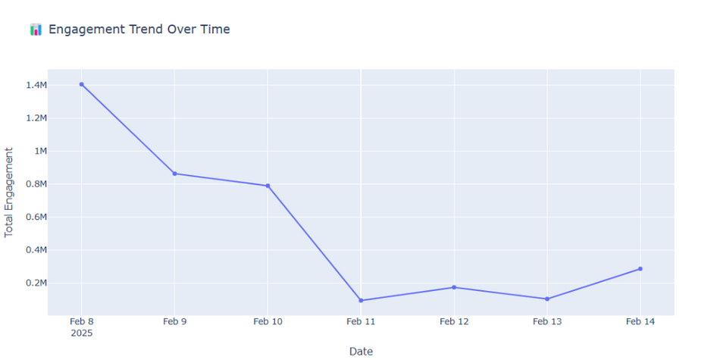
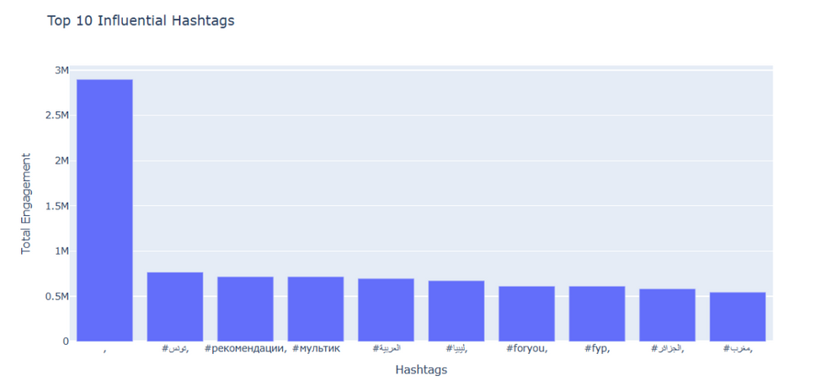
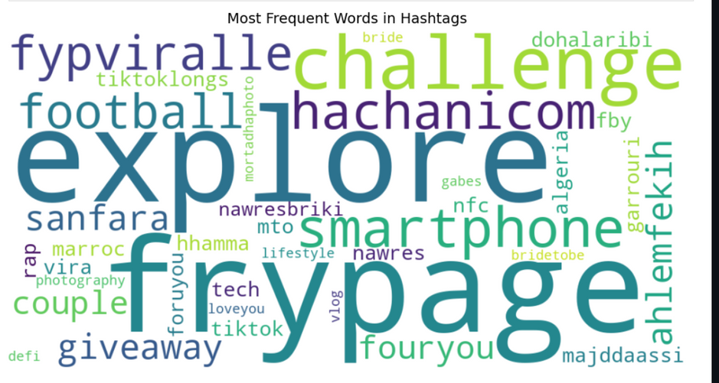
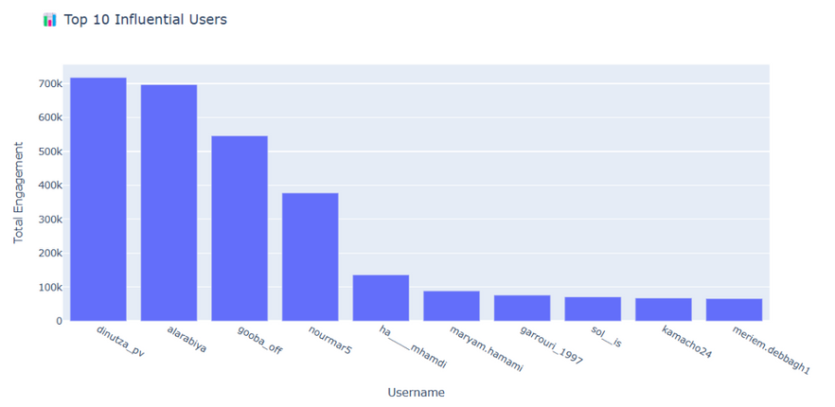

03.2 TikTok trends Visualizations
05/10

Slide 8
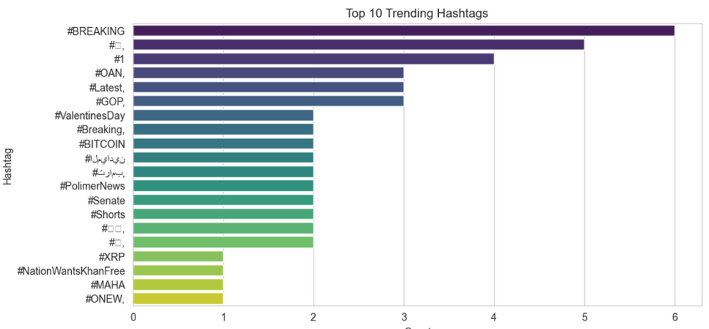
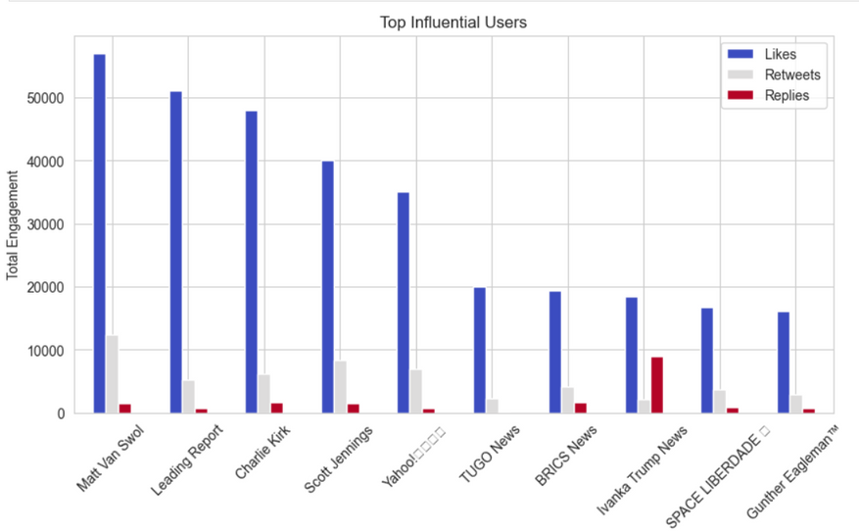
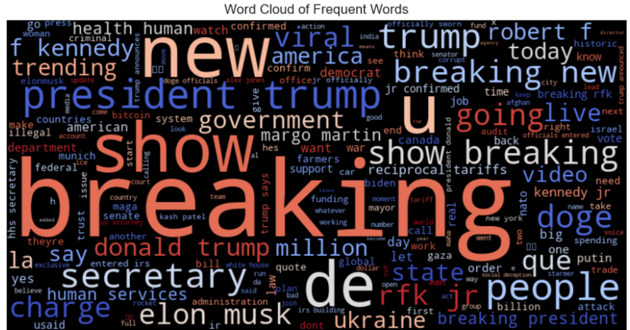
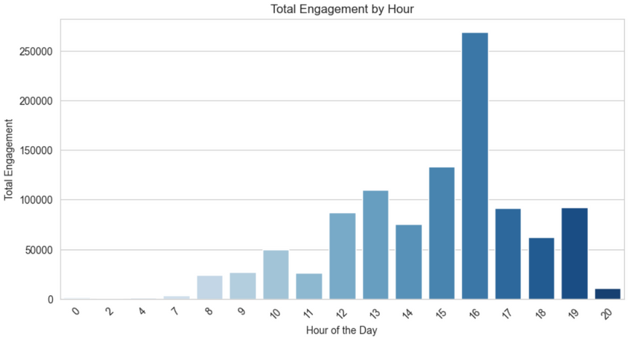
03.3 X trends Visualizations
06/10

Slide 9
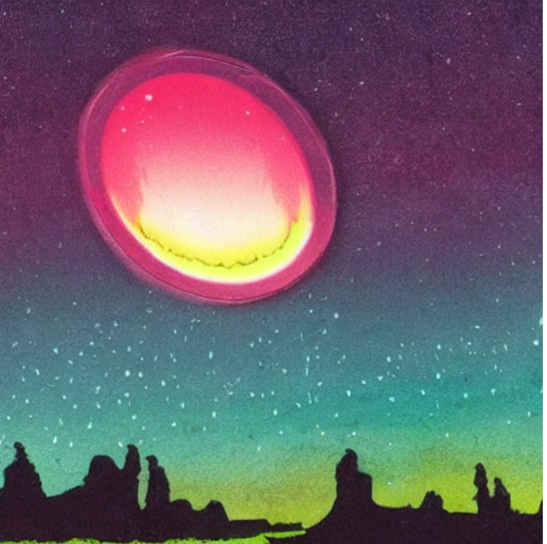
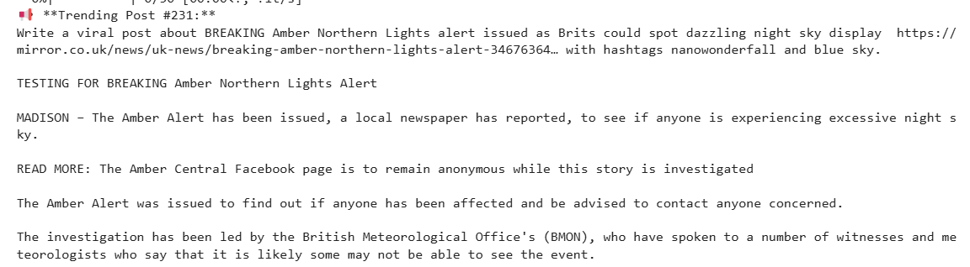
03.3 X generative model outputs
03.3.1 Trend Image and caption generated
07/10

Slide 10
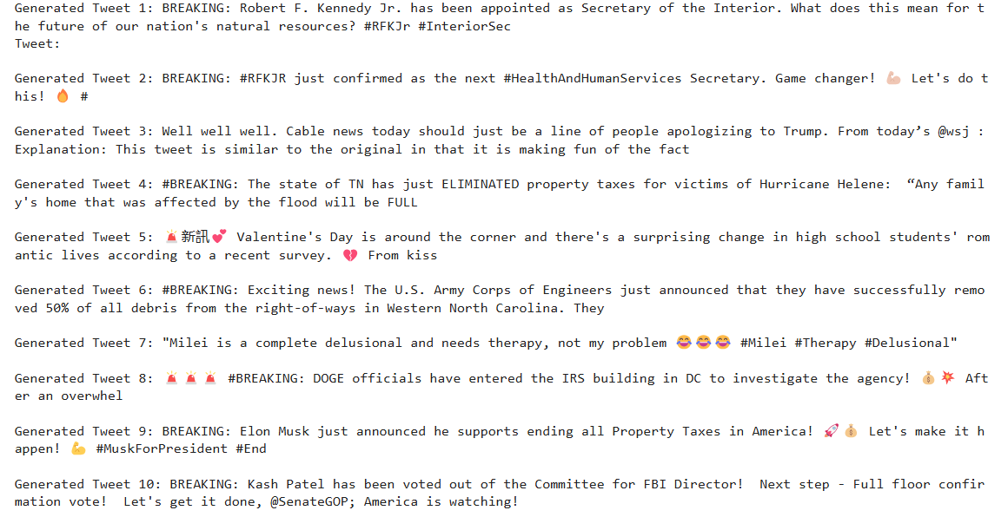
03.3.2 Trend text generated
08/10

Slide 11





04 Market & Future Impact
Media Managers
Marketers
AI TrendGen
Influencers
Brands
09/10

Slide 12

Thank you for your Attention !
10/10

